Slide 1



2025 LiverPool Victoria Practitioner’s Challenge
Department of Statistics
GROUP 2:
LAXMAN SUDHAN - 50714
RAM RIDHAN - 49775
MUFANG YANG - 40658
YASH MISHRA - 44369
PENG XIANG - 47743

Slide 2
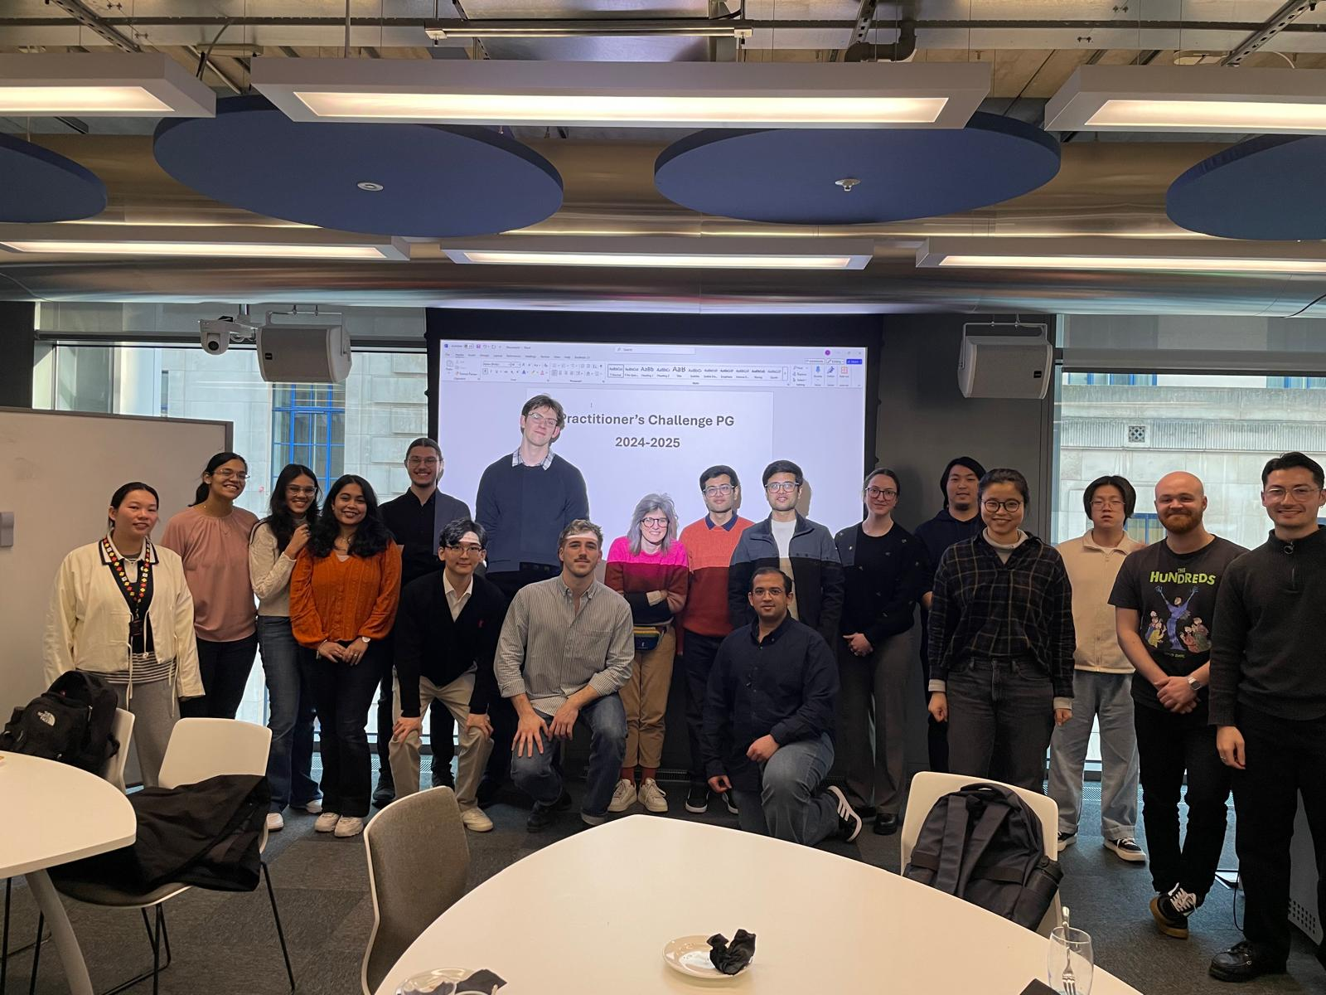

Slide 3


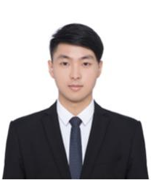
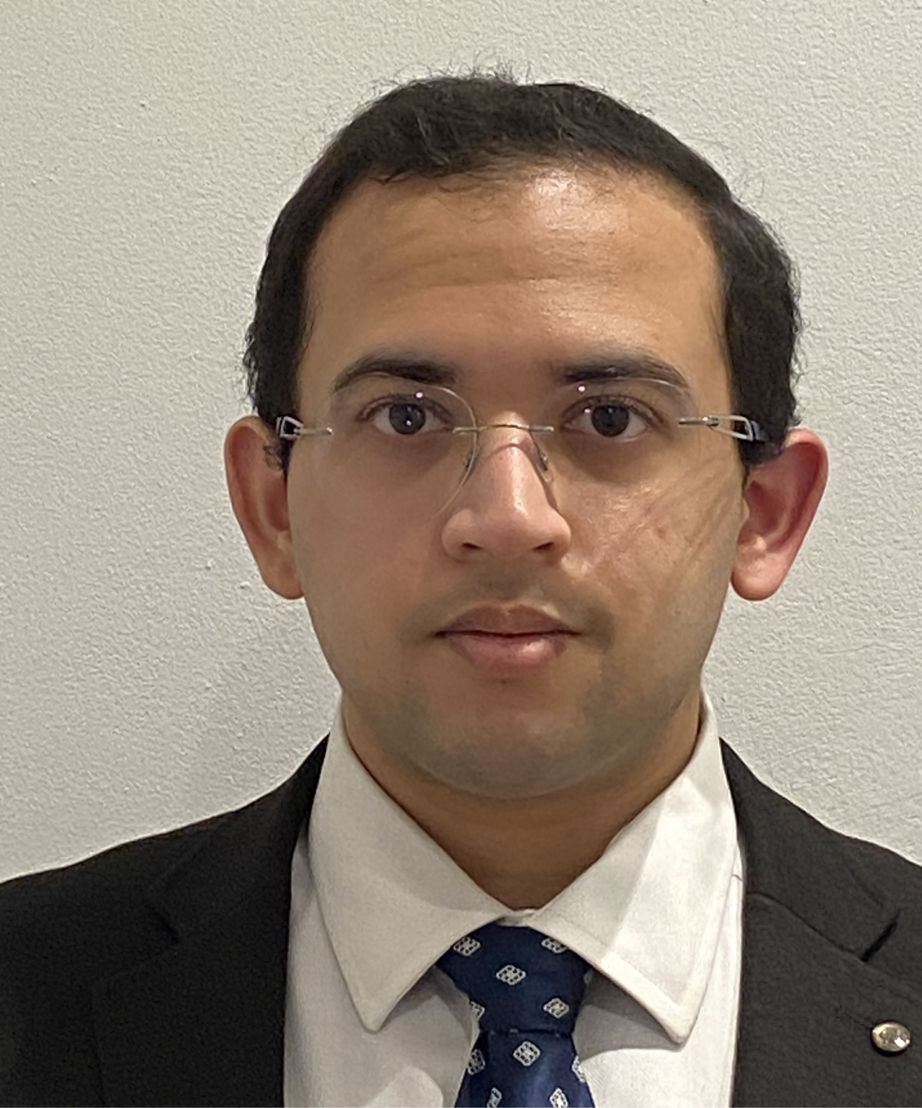

Laxman Sudhan
Mufan Yang
Ram Ridhan
MSc Data Science
MSc Quantitative methods for Risk Management
MSc Data Science
Yash Mishra
Peng Xiang
MSc Financial Statistics ( Research)
MSc Quantitative methods for Risk Management

Slide 4


Predicting Insurance Claim Costs: A Data-Driven Approach for Premium Development

Slide 5

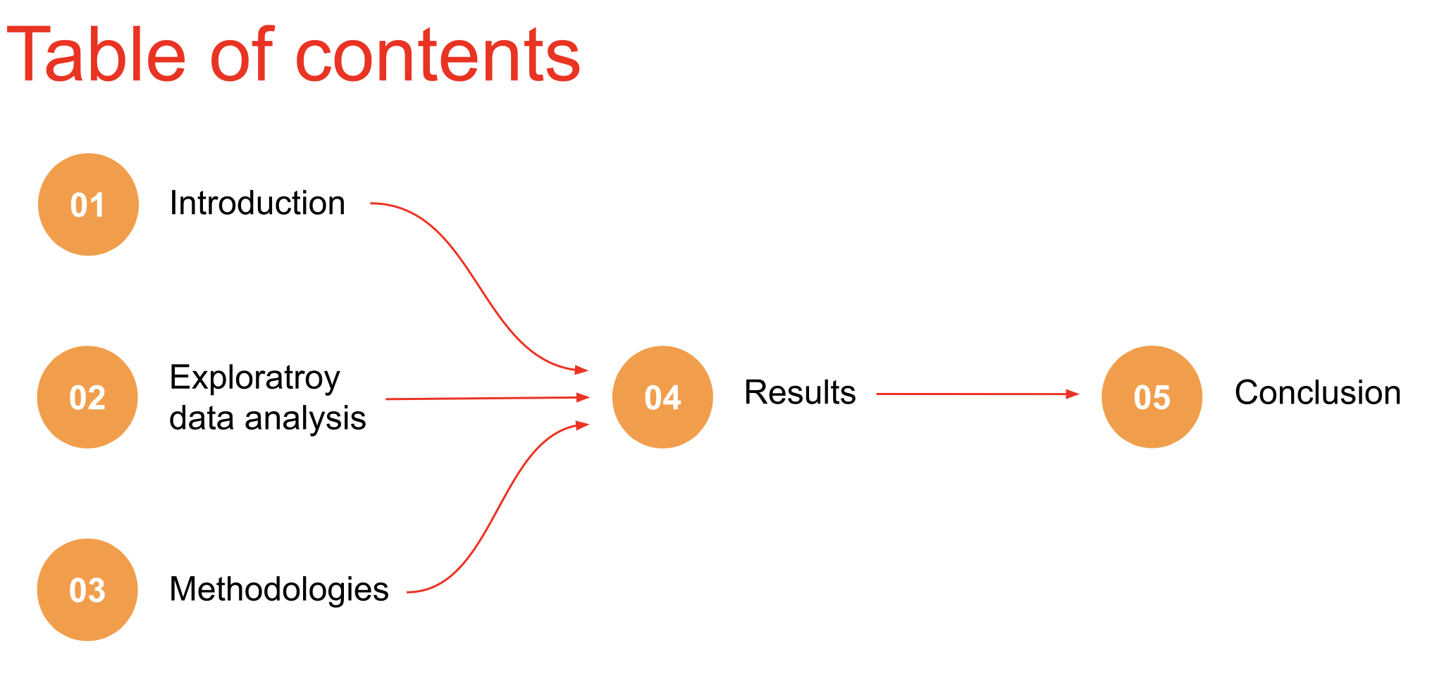

Slide 6
CHALLENGE
Analyse claim frequency and severity through either separately or combined approach using machine learning models to develop accurate cost estimates and quantify uncertainty.

Slide 7
ABOUT DATASET
Key Predictors:
• Exposure – Duration of coverage (in years)
• CarAge, DriverAge – Vehicle and driver characteristics
• Power – Engine power category
• Brand, Gas, Region – Vehicle and geographic attributes
• Density – Regional population density
Target Variables:
• ClaimNb: Number of claims
• ClaimAmount: Total cost of claims
• PurePremium: Calculated as ClaimAmount / Exposure
Size:
•330,535 rows
•12 columns

Slide 8
Data preparation and Cleaning
The merged dataset has 12 columns with 330,535 obsearvations. The target variable to be predicted is PurePremium.
Risk factors: (DriverAge, CarAge, Power)
Categorical attributes: ( Region, Brand, Gas)
Removed column: (Unnamed: 0, Exposure)

Slide 9
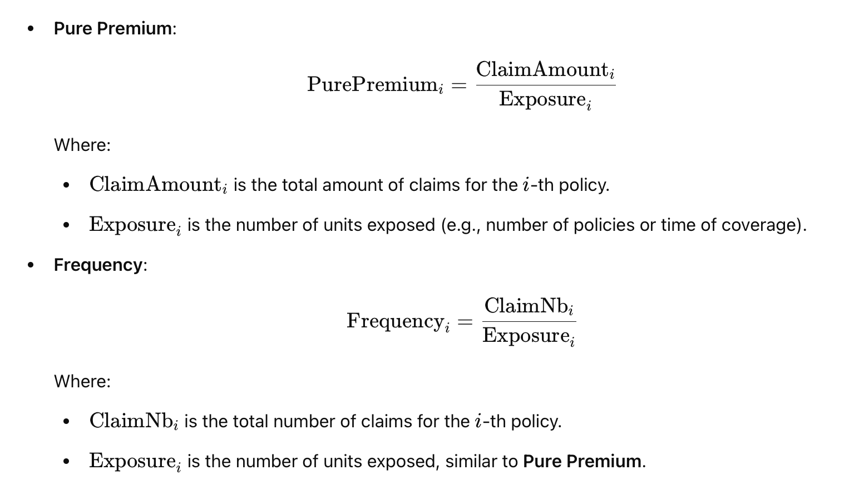
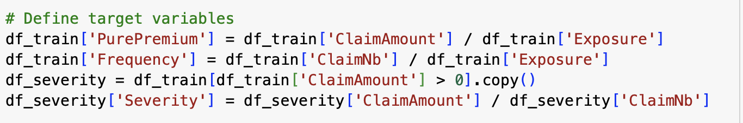
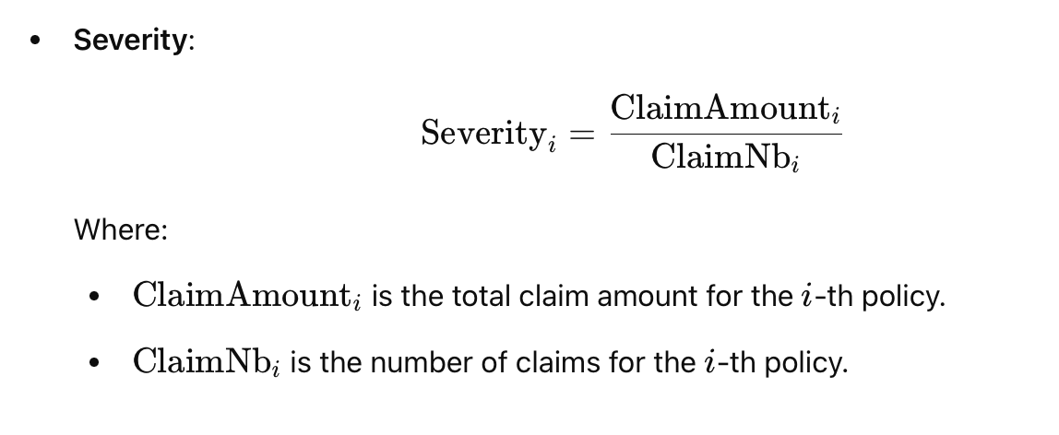
Defining Target Variables

Slide 10
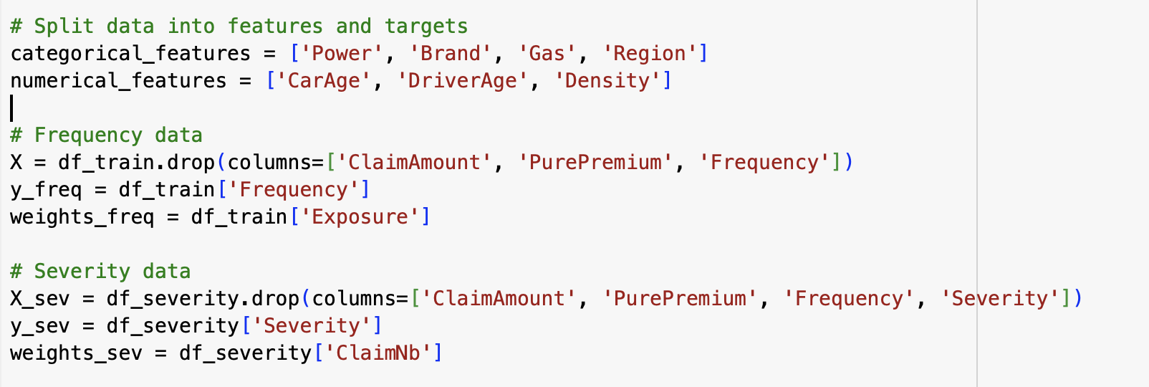
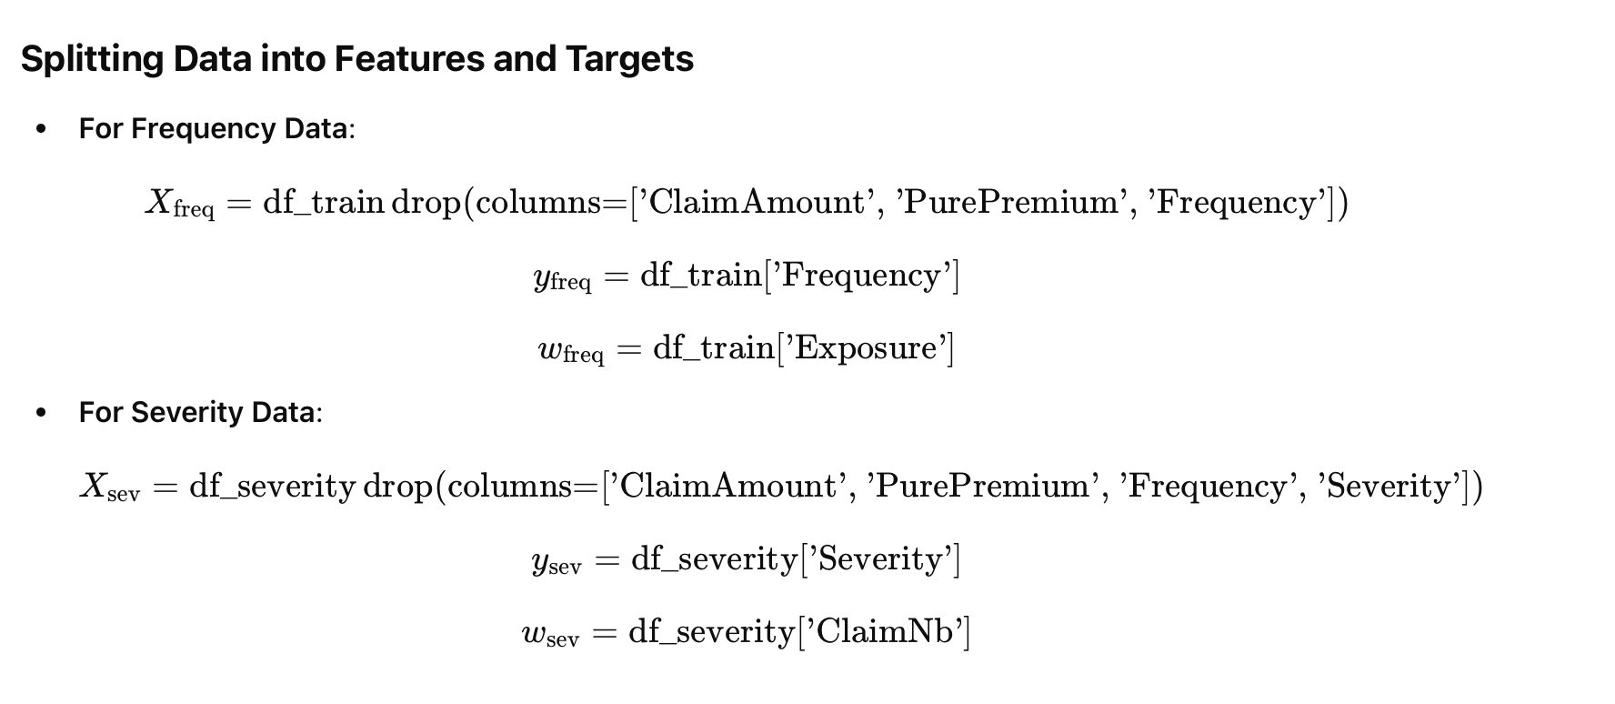
Splitting Data into Features and Targets

Slide 11

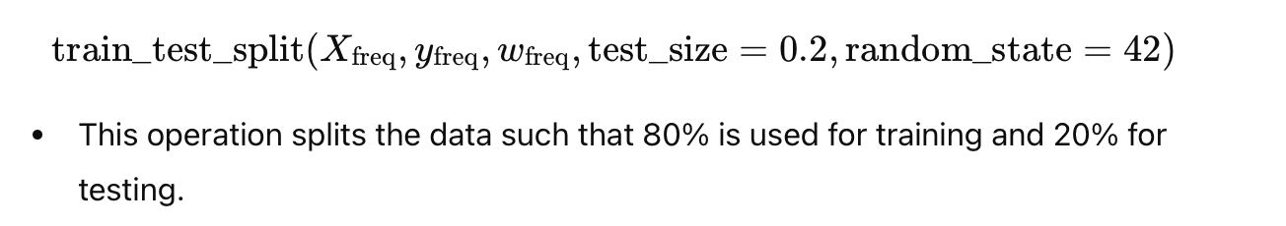
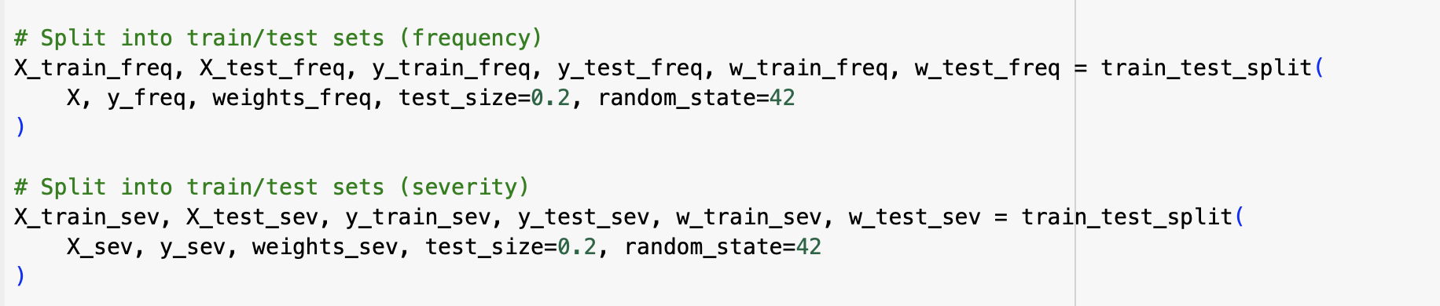

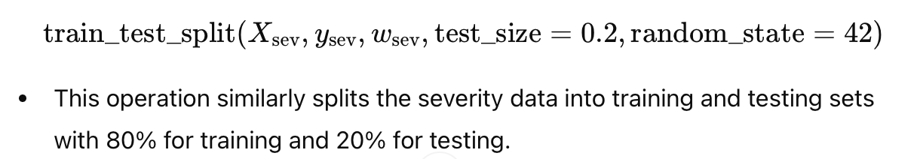
Train Test Split

Slide 12
Exploratory Data Analysis

Slide 13
Exploratory Analysis Overview
Data preparation and cleaning
Univariate Data Analysis
Bivariate Data Analysis
Multivariate Data Analysis

Slide 14
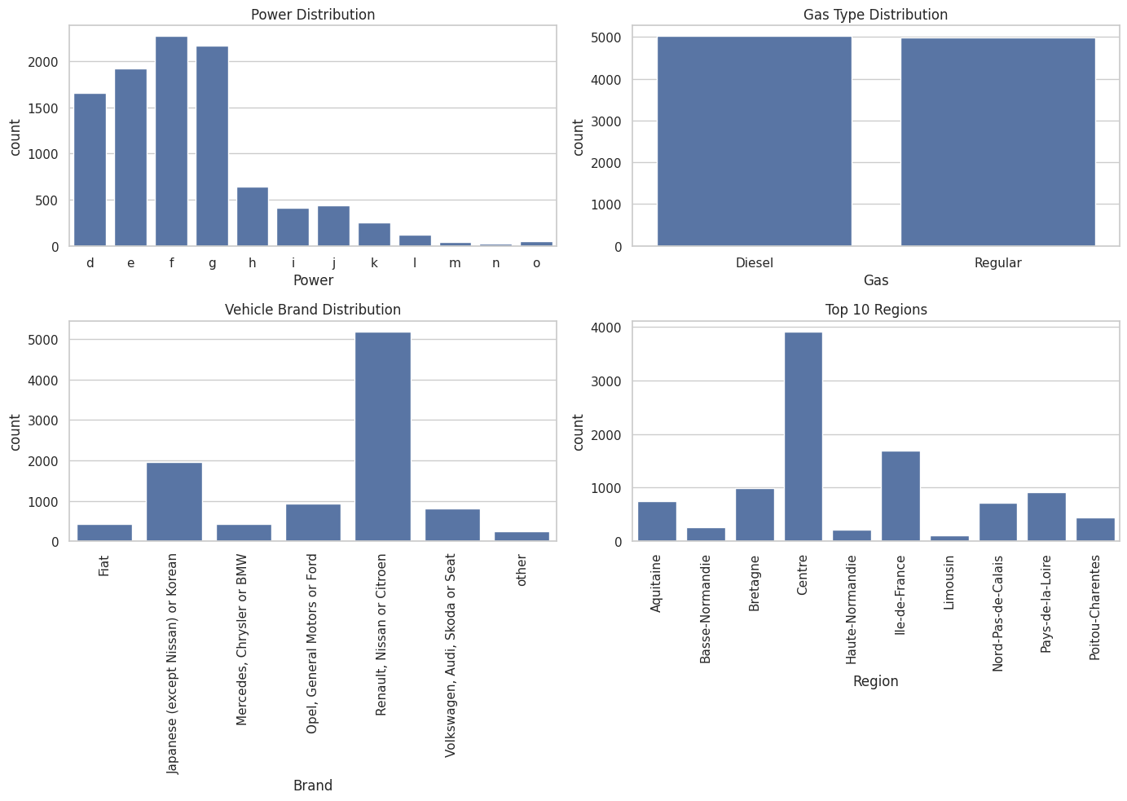

Slide 15
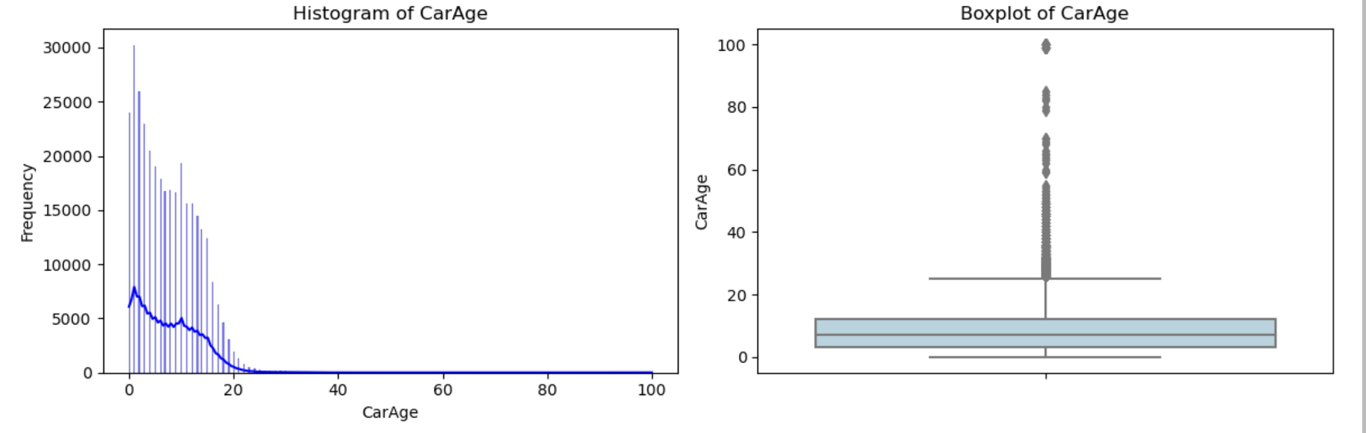
Univariate Analysis

Slide 16
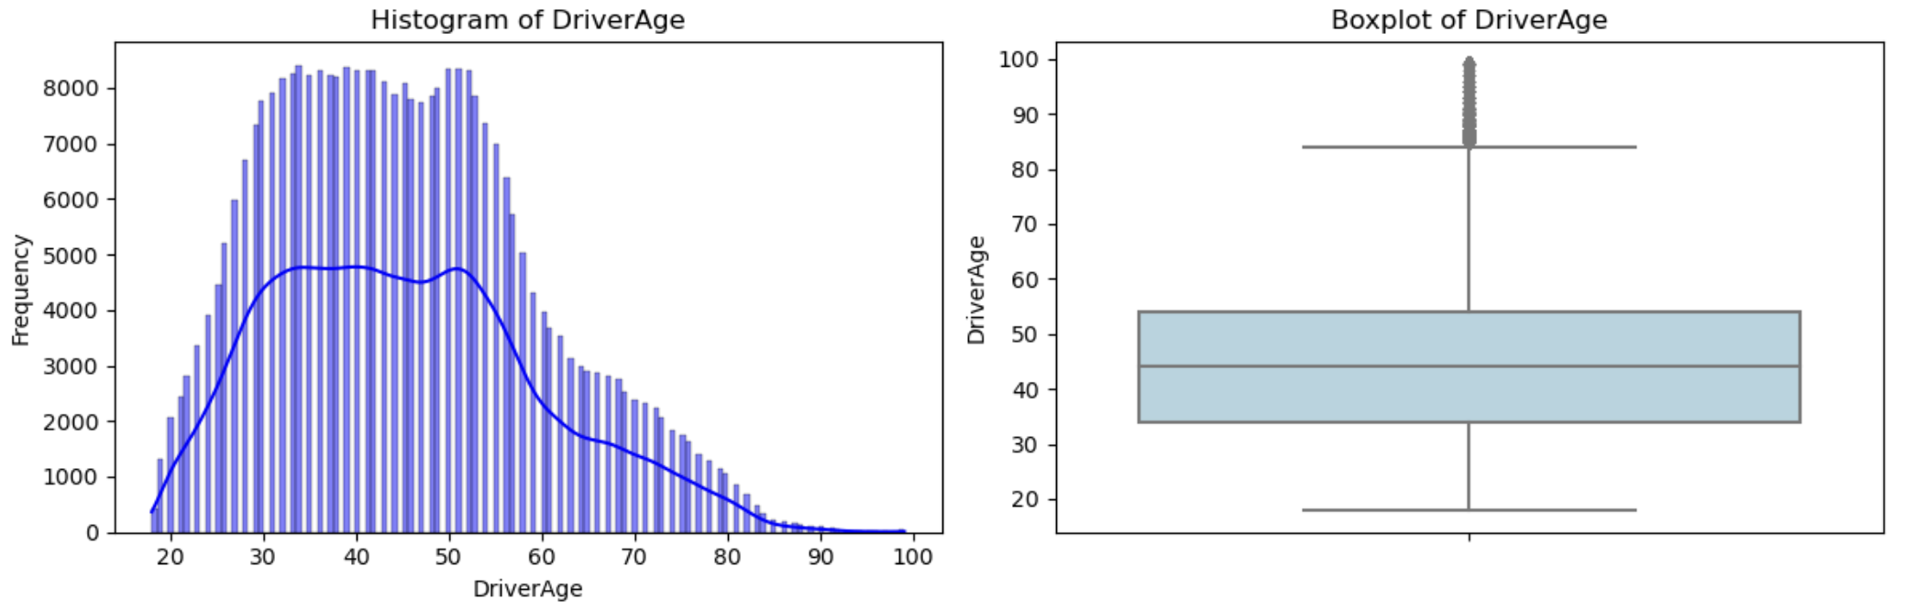
Univariate Analysis

Slide 17
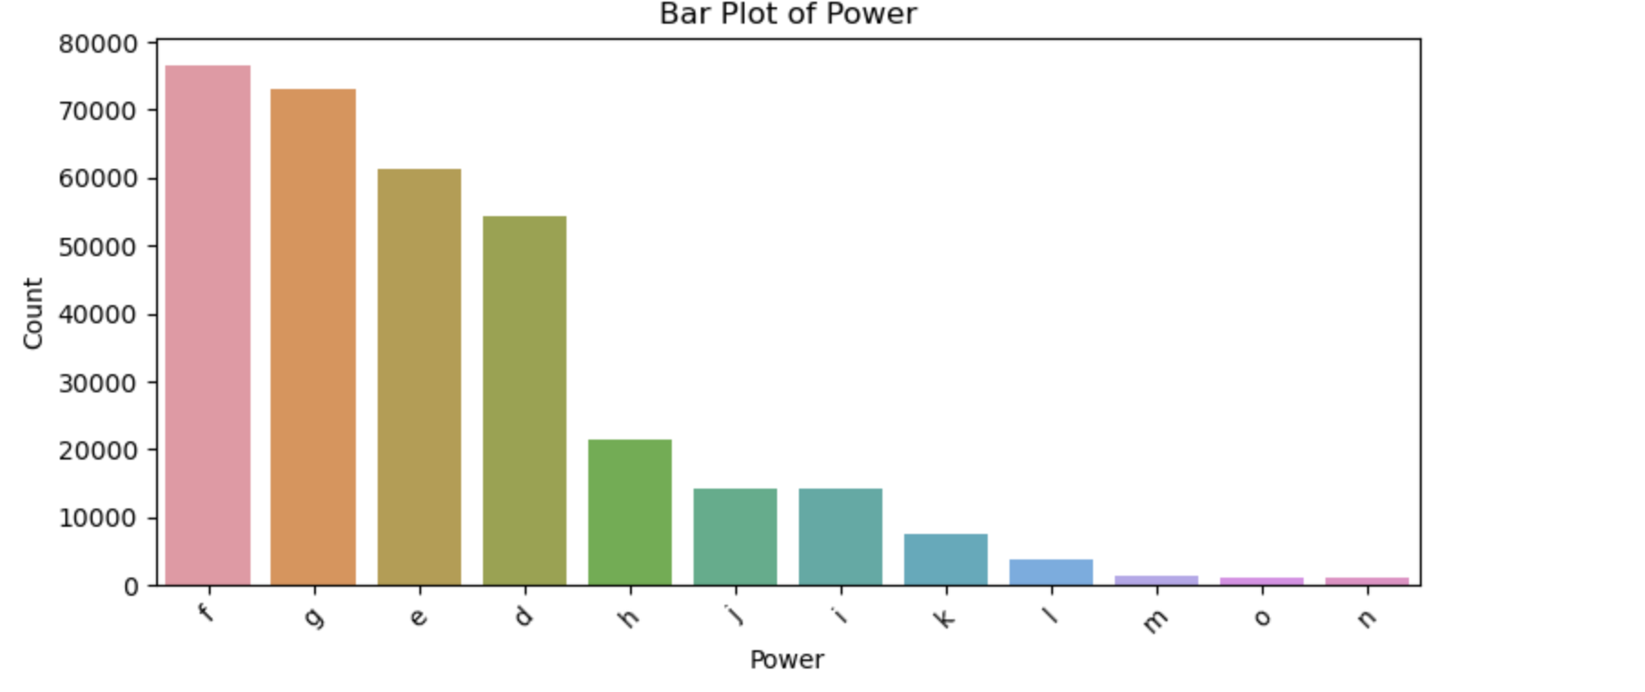
Univariate Analysis

Slide 18
Bivariate Analysis
According to the plot, there exist significant dependence between variables
In this section we aim to illustrate the bivariate plot between variables.

Slide 19
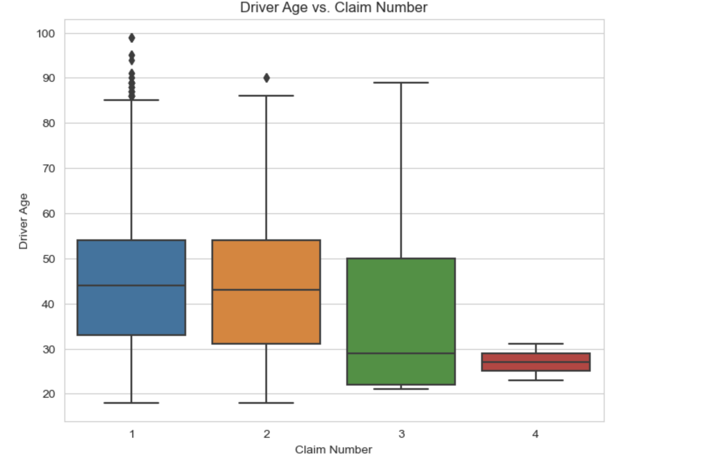
Bivariate Analysis
Driver Age VS Claim Number

Slide 20
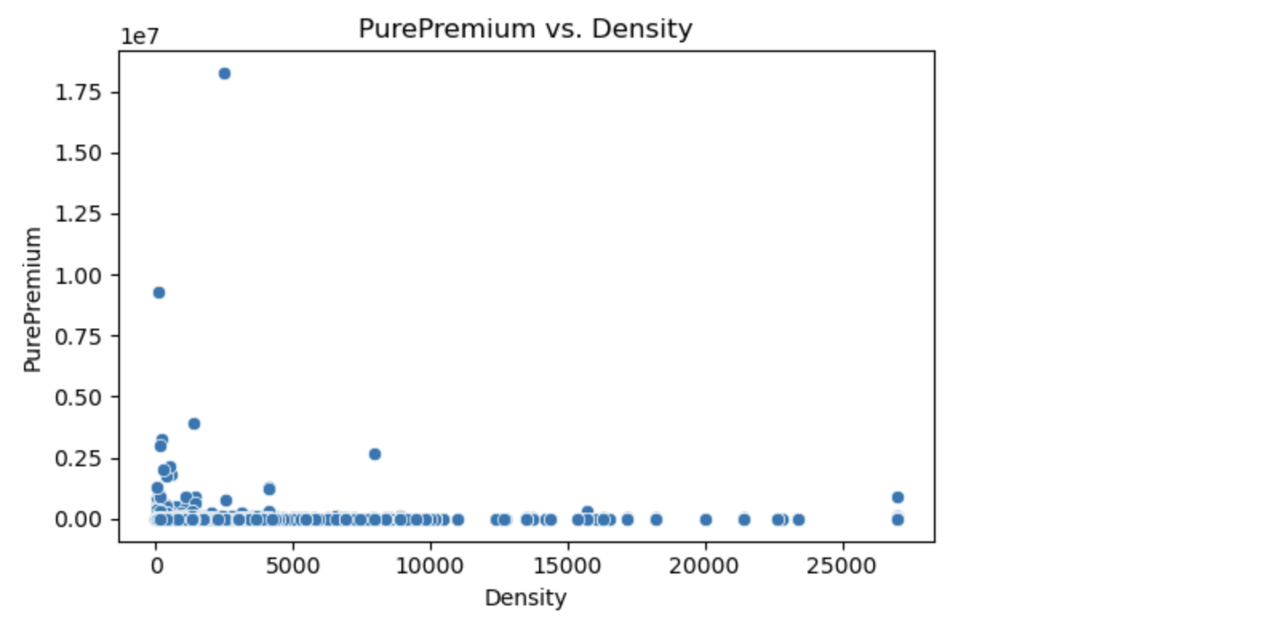
Bivariate Analysis
Pure Premium VS Density

Slide 21
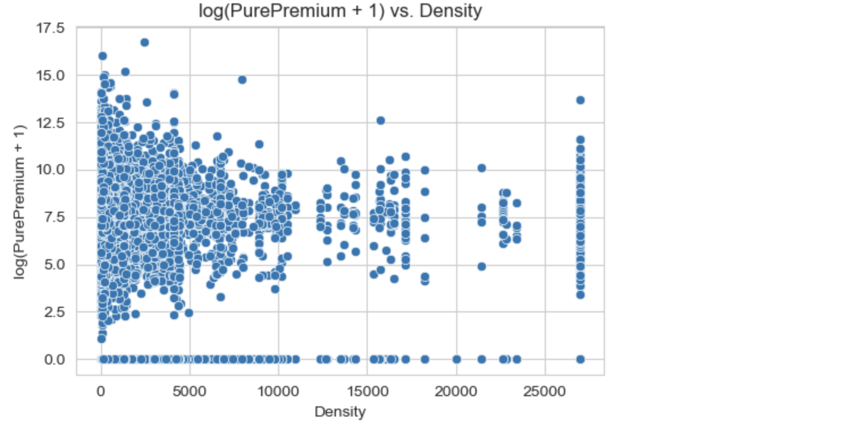
Bivariate Analysis
logged Premium VS Density

Slide 22
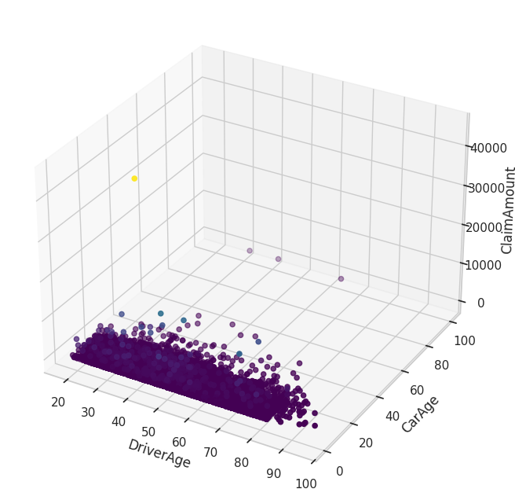
Bivariate Analysis
Driver Age VS Claim Amount

Slide 23
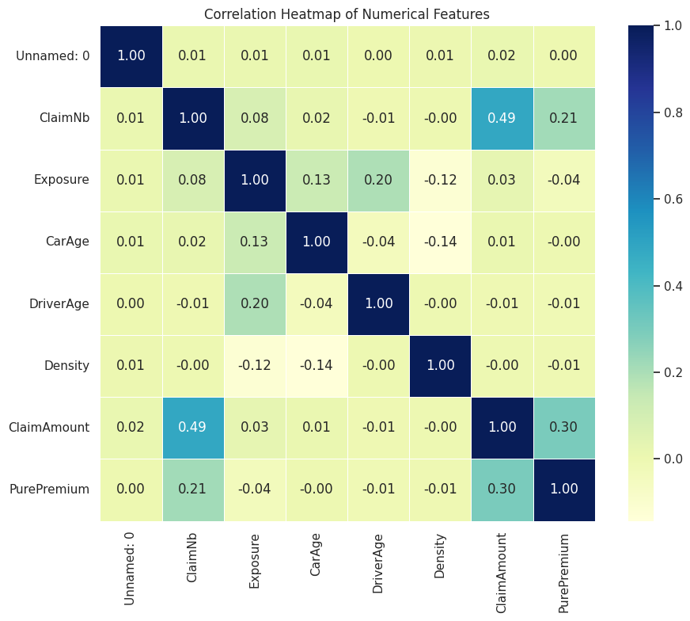
Multivariate Analysis

Slide 24
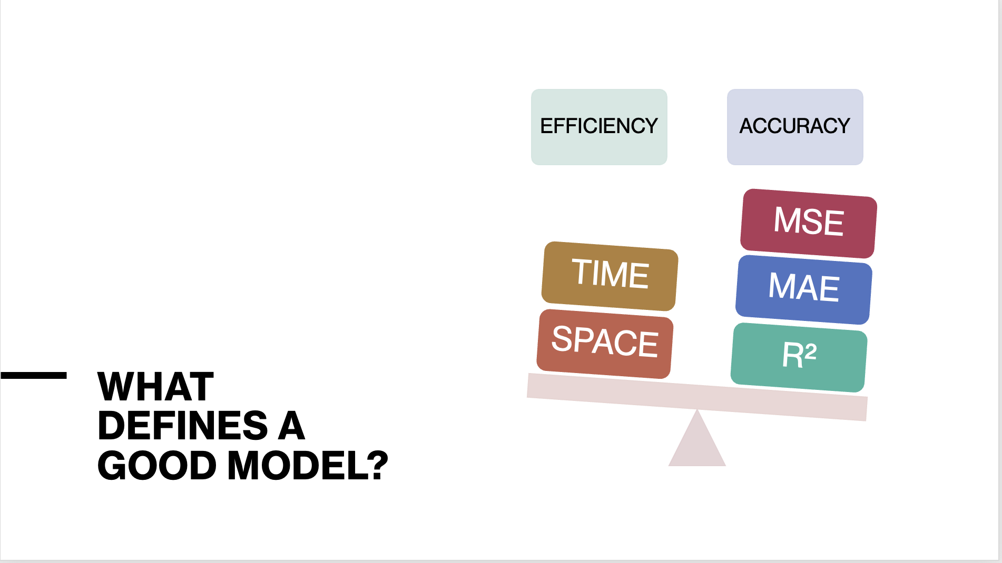

Slide 25
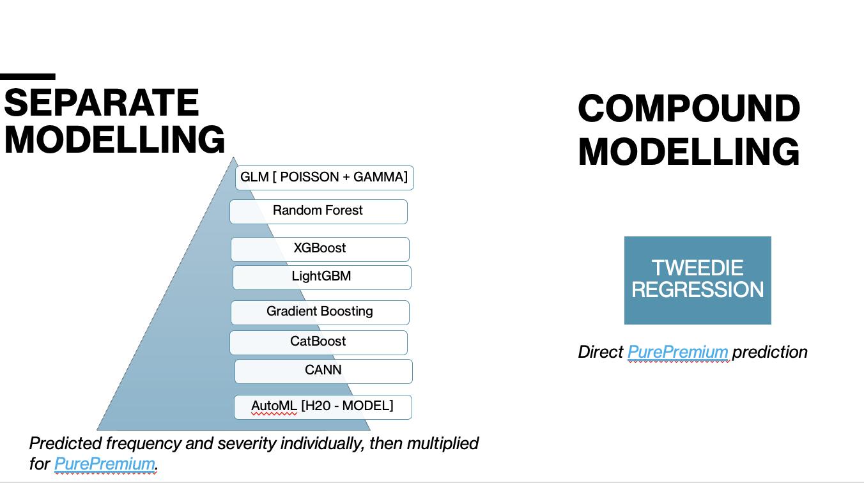

Slide 26
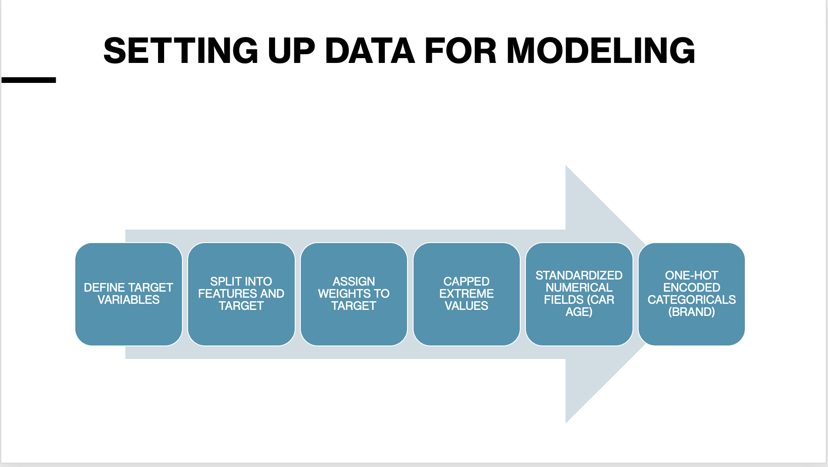

Slide 27
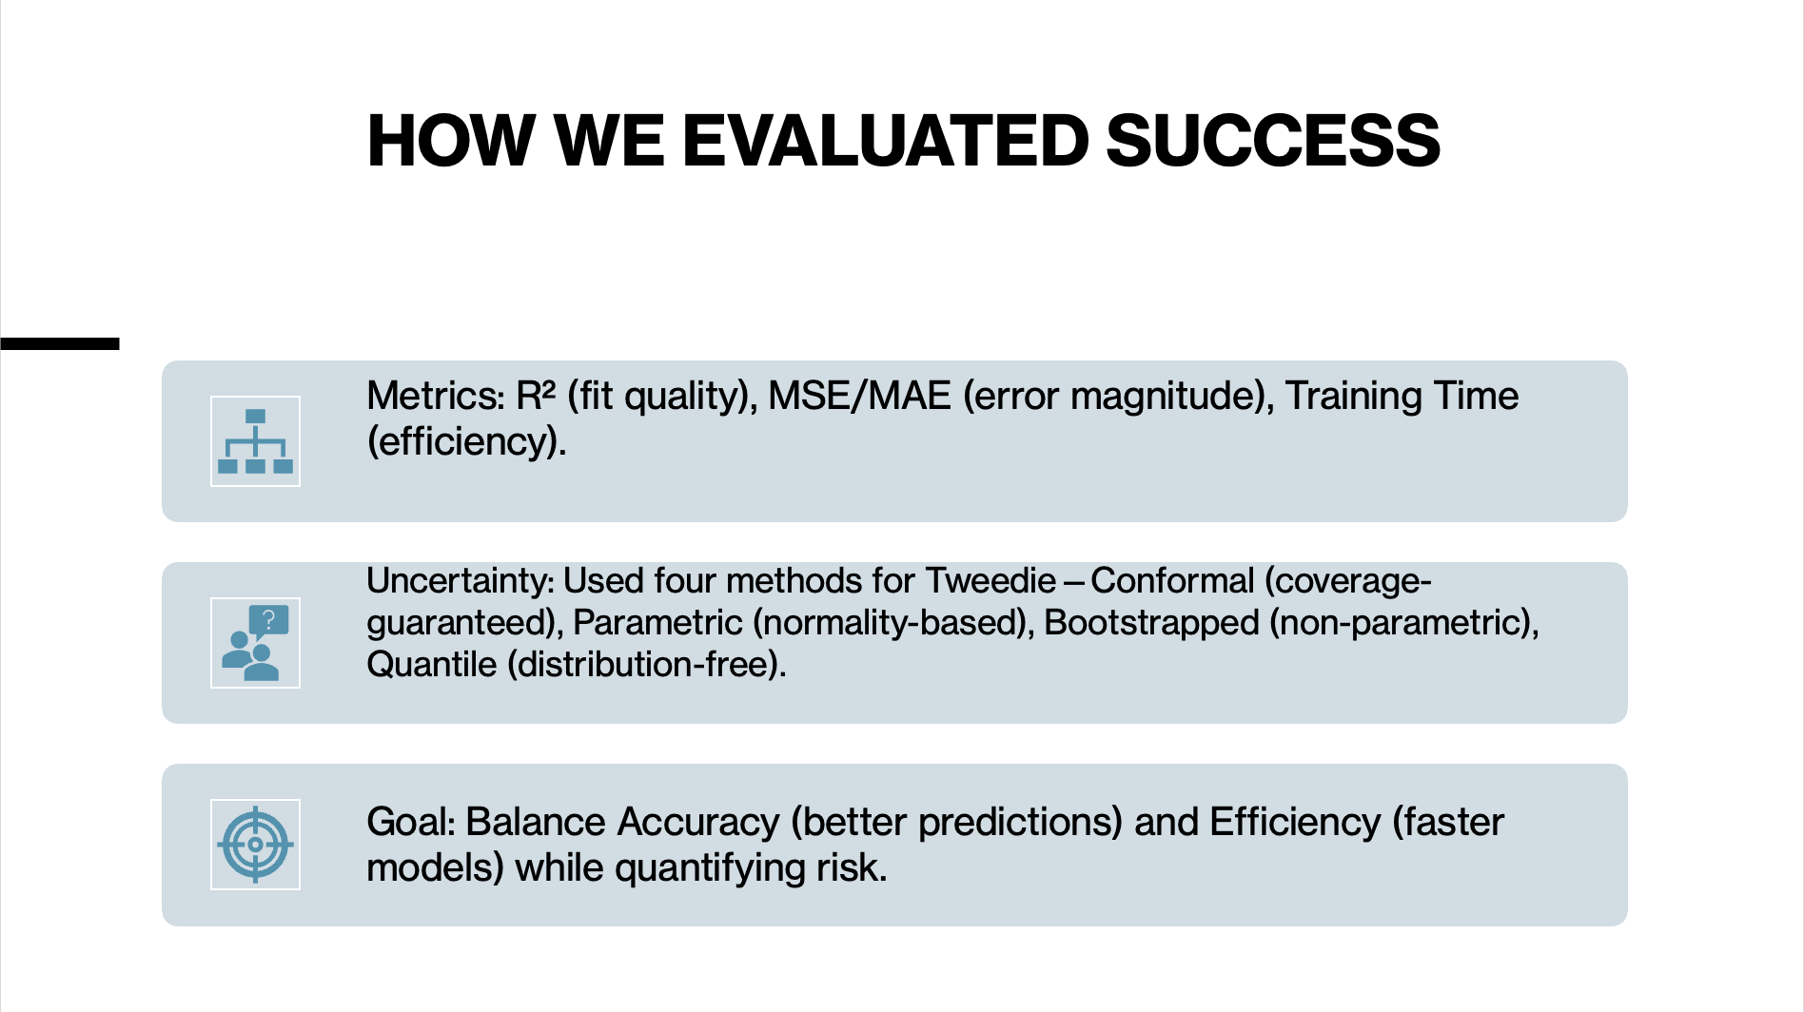

Slide 28
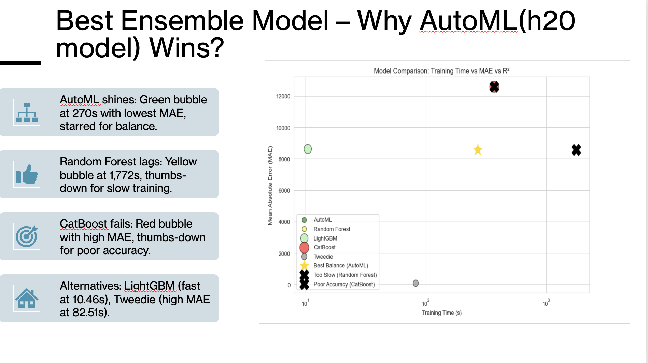

Slide 29
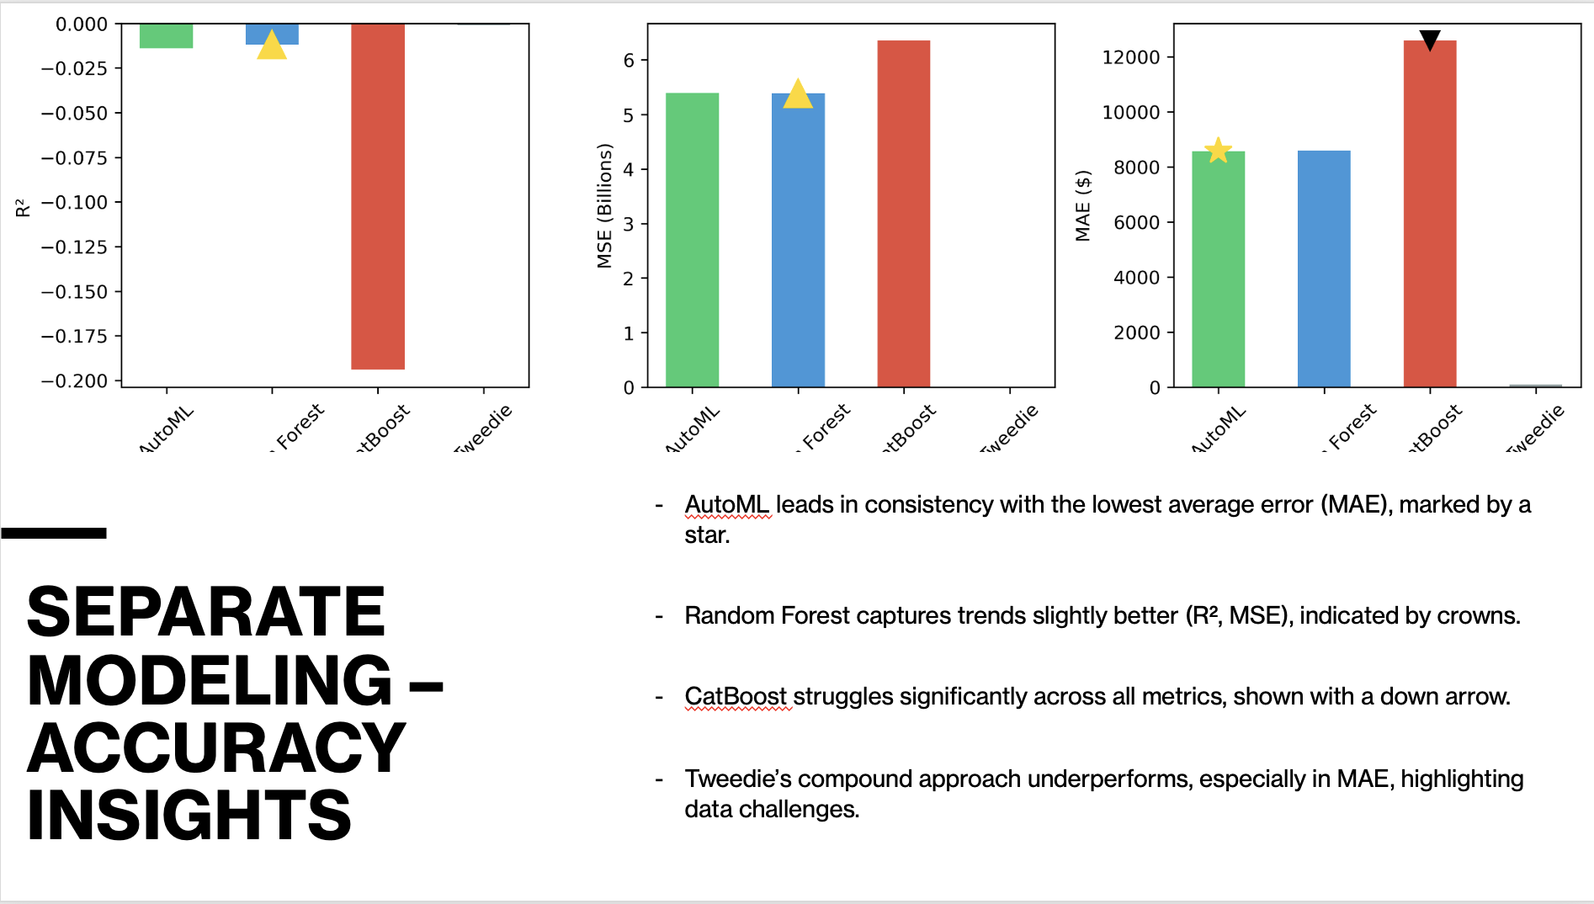

Slide 30
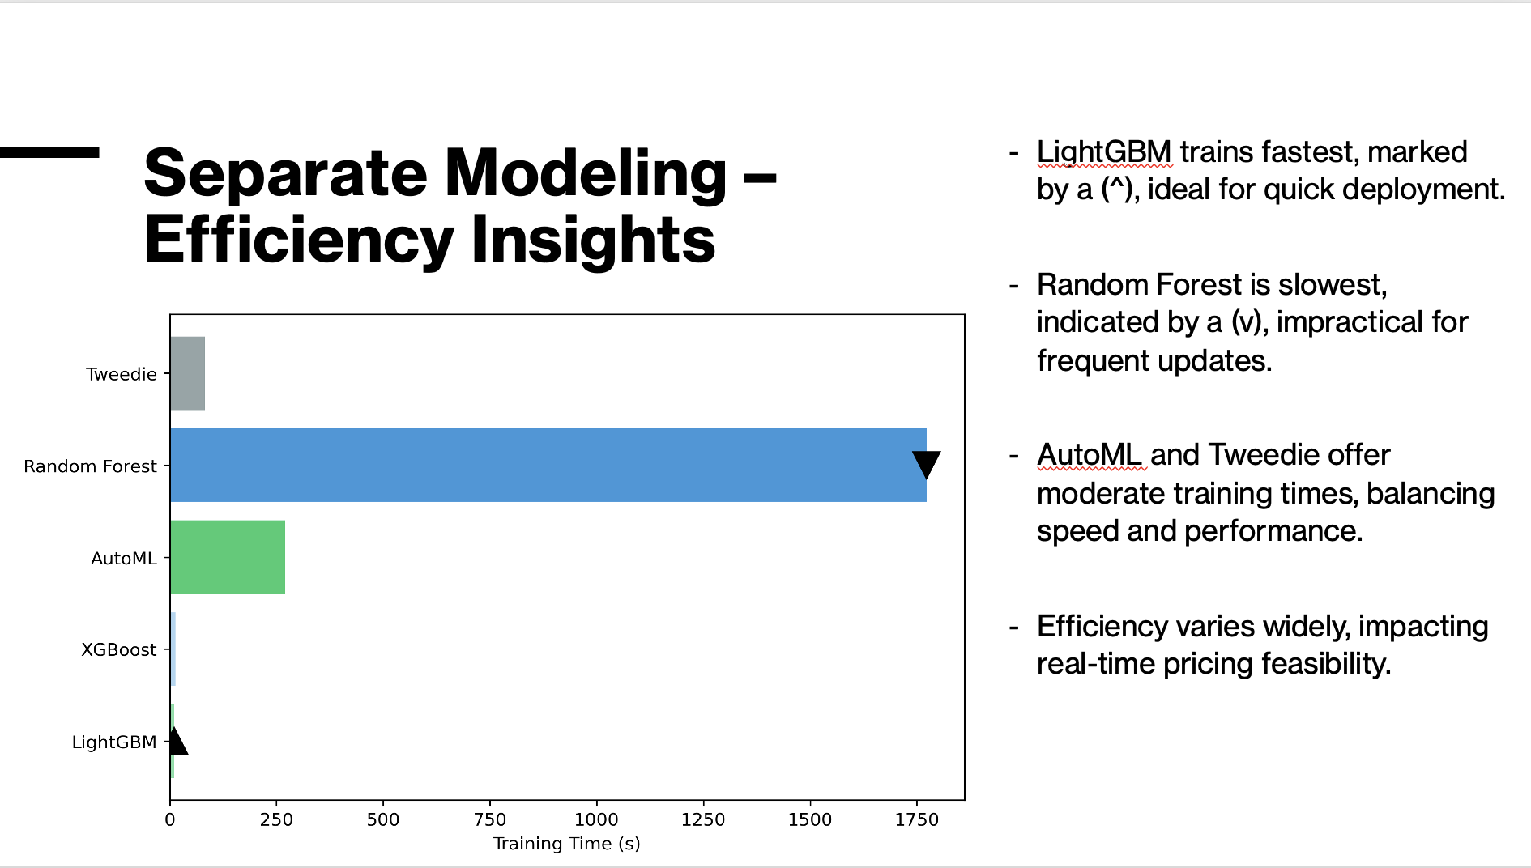

Slide 31
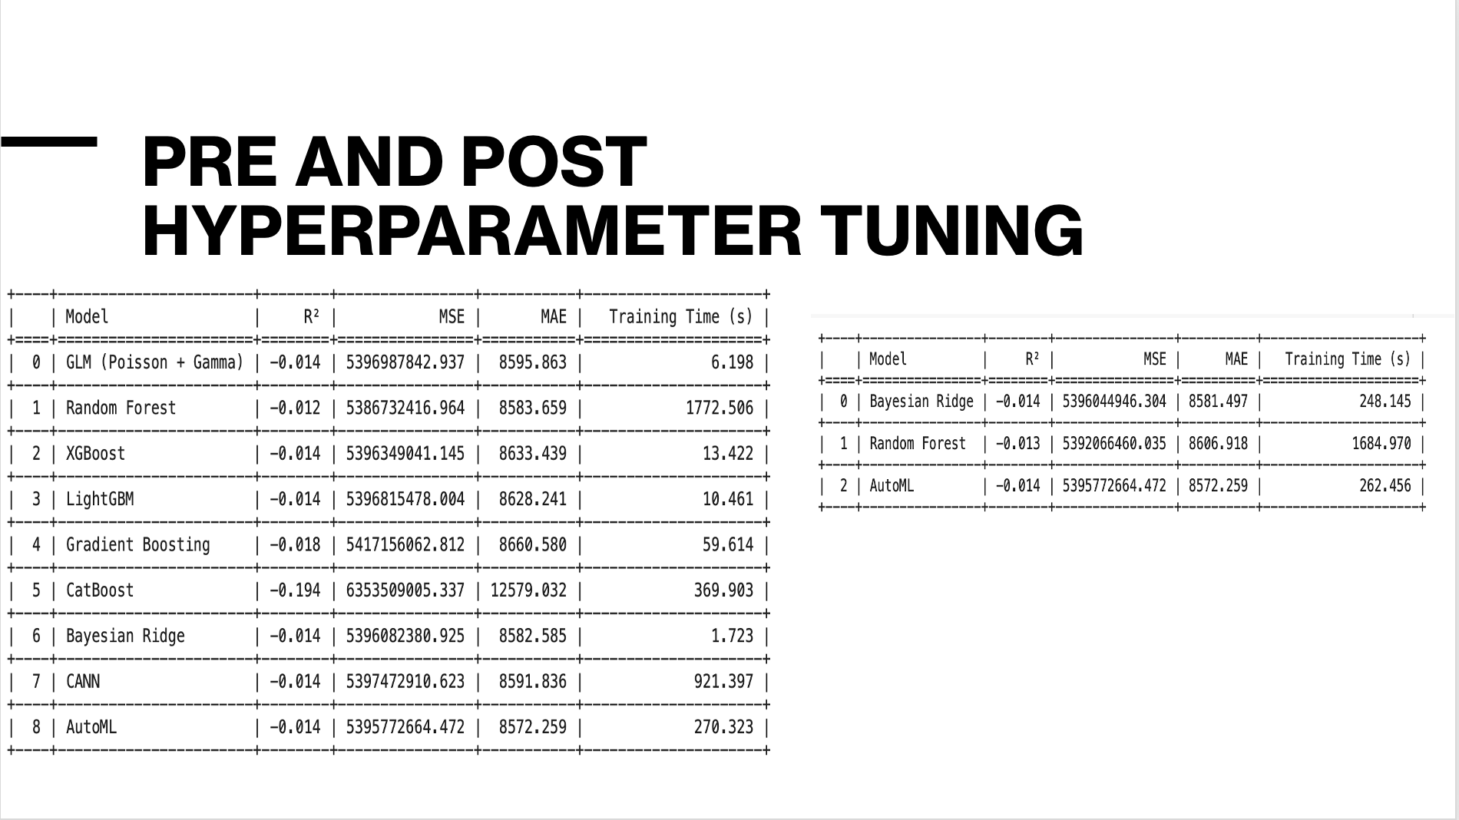

Slide 32
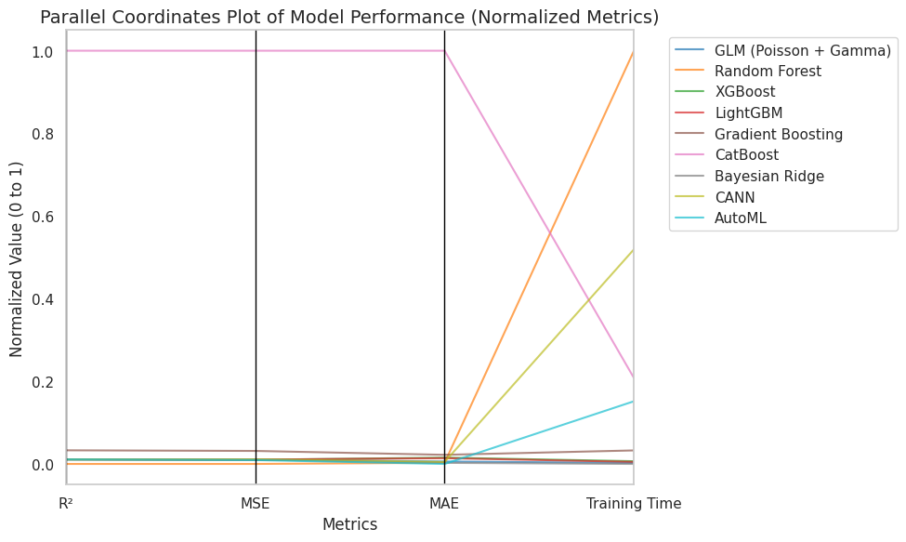

Slide 33
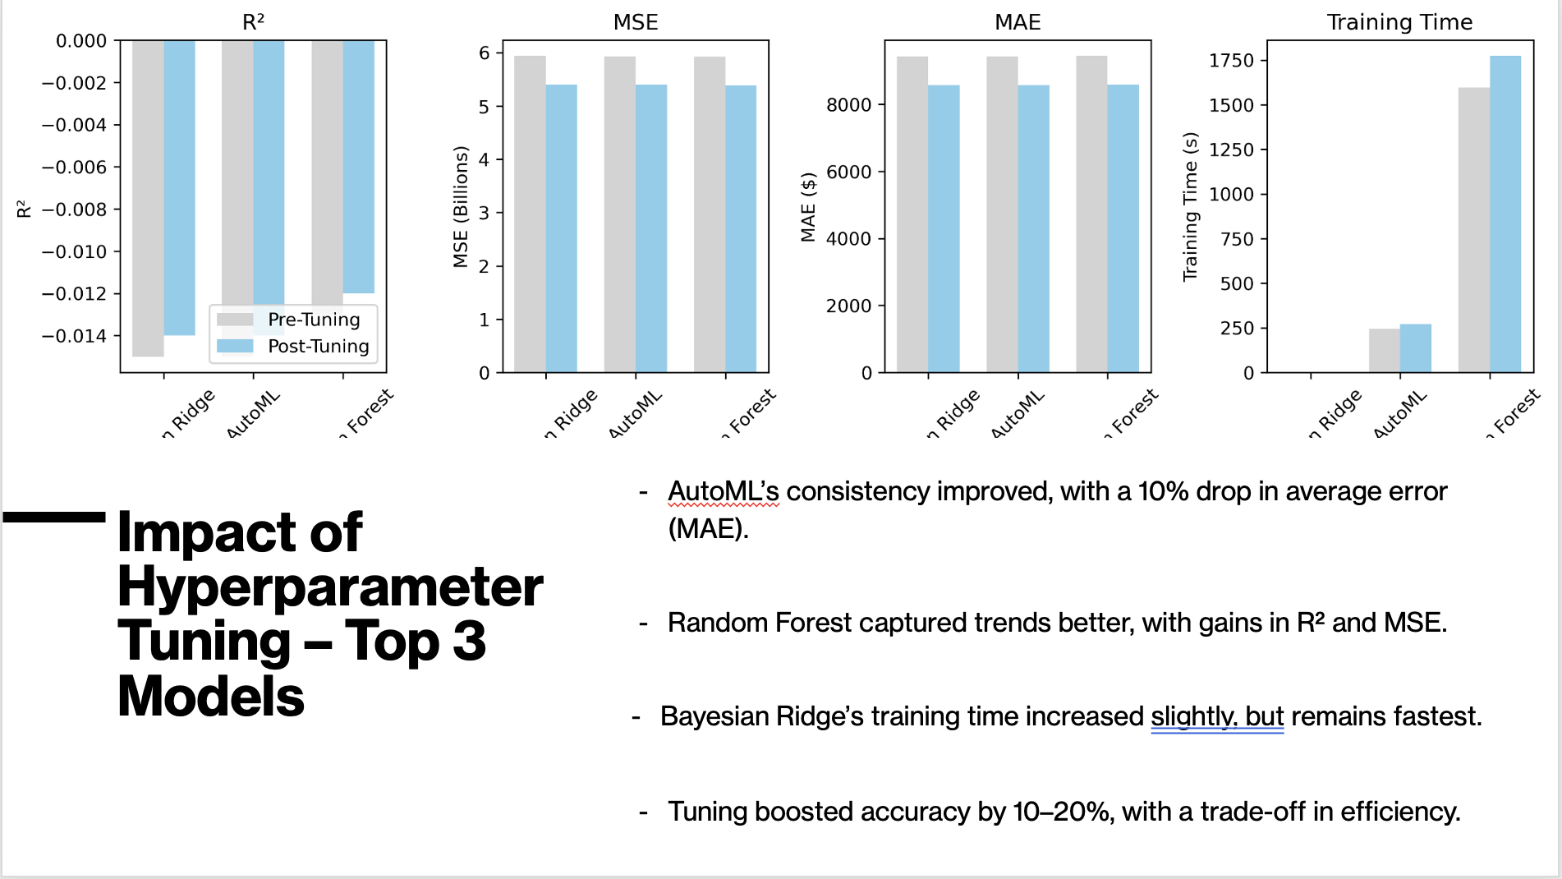

Slide 34
COMPOUND MODELING
TWEEDIE REGRESSION

Slide 35
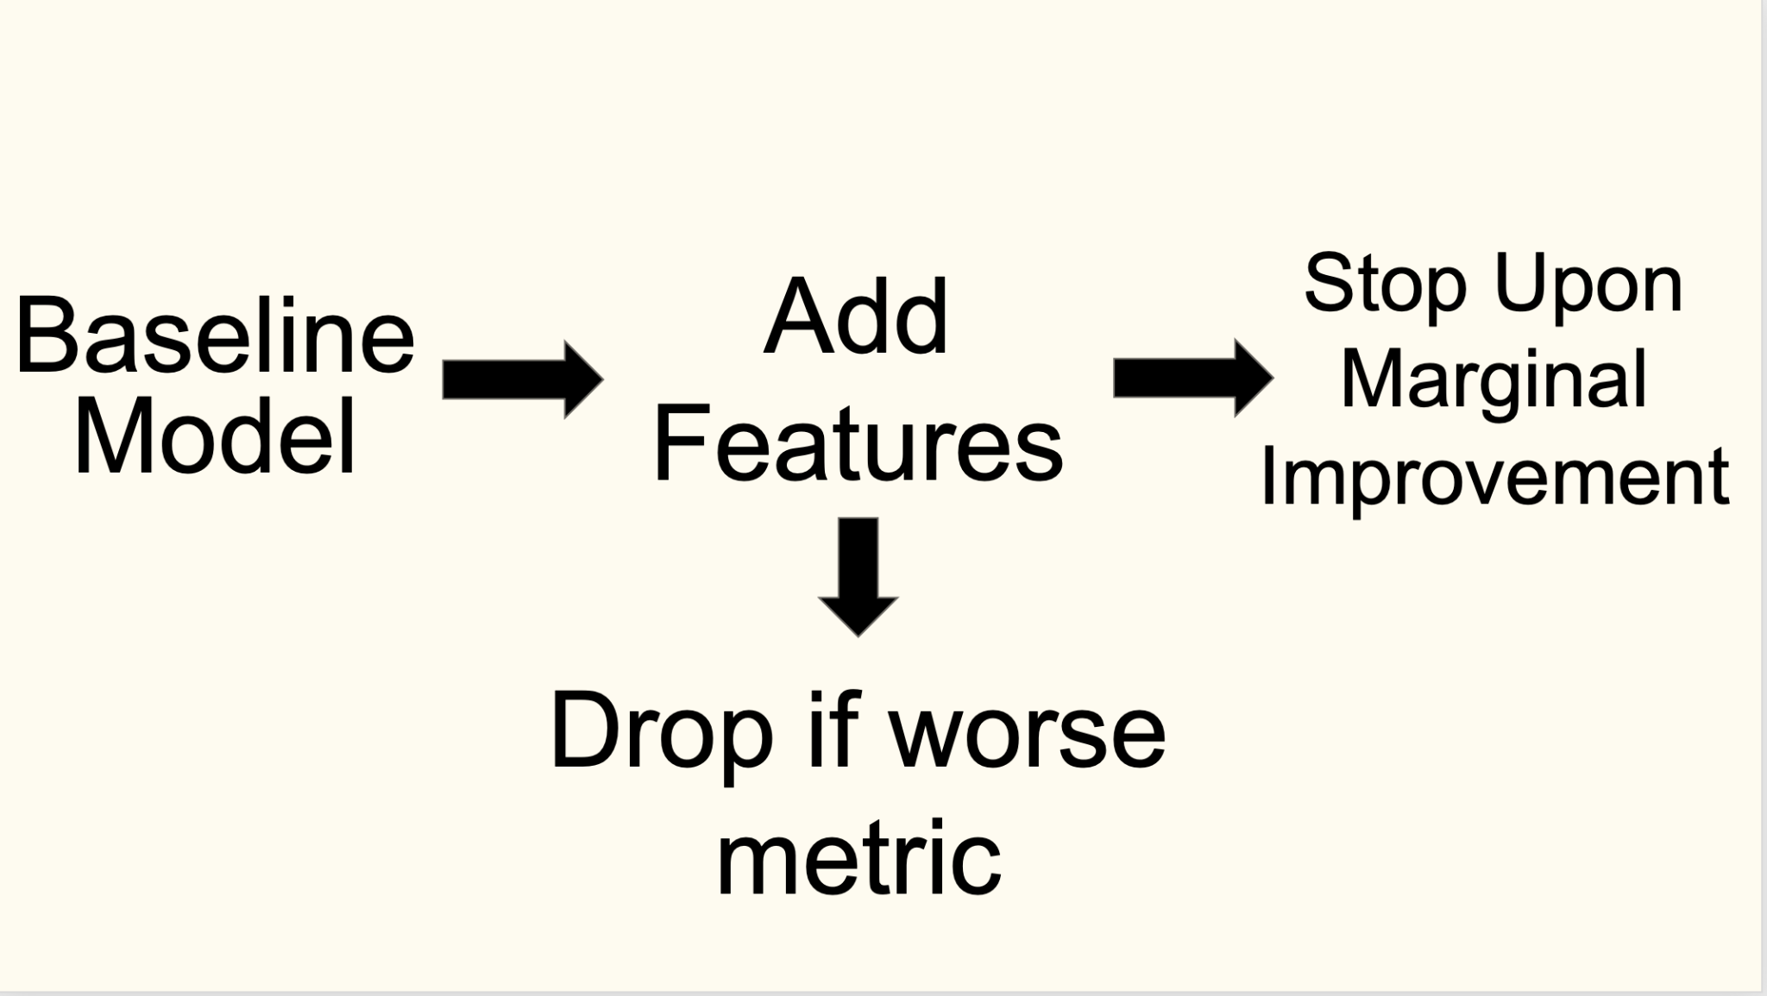

Slide 36
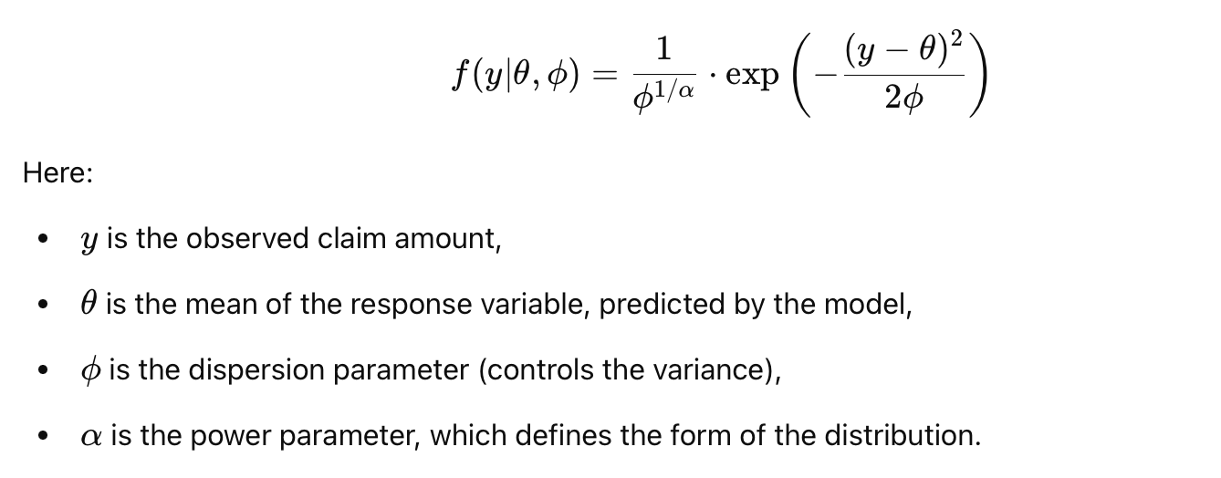
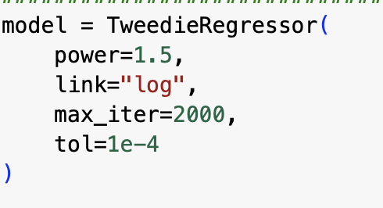
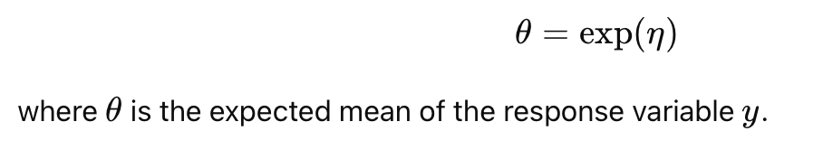
TWEEDIE REGRESSION

Slide 37
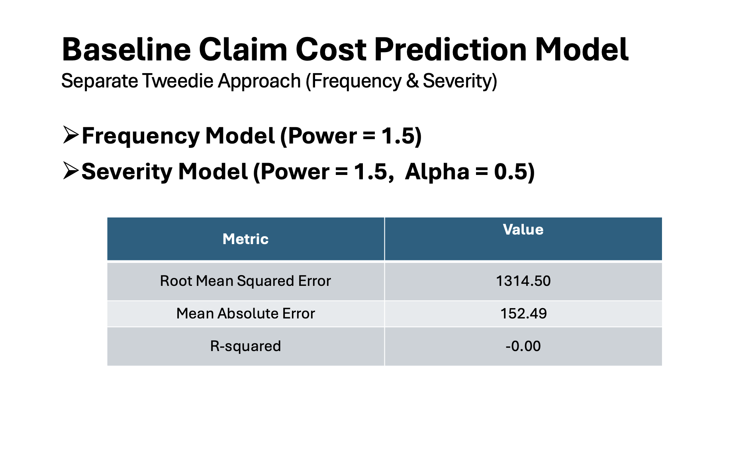
Tweedie Approach (Frequency & Severity)

Slide 38
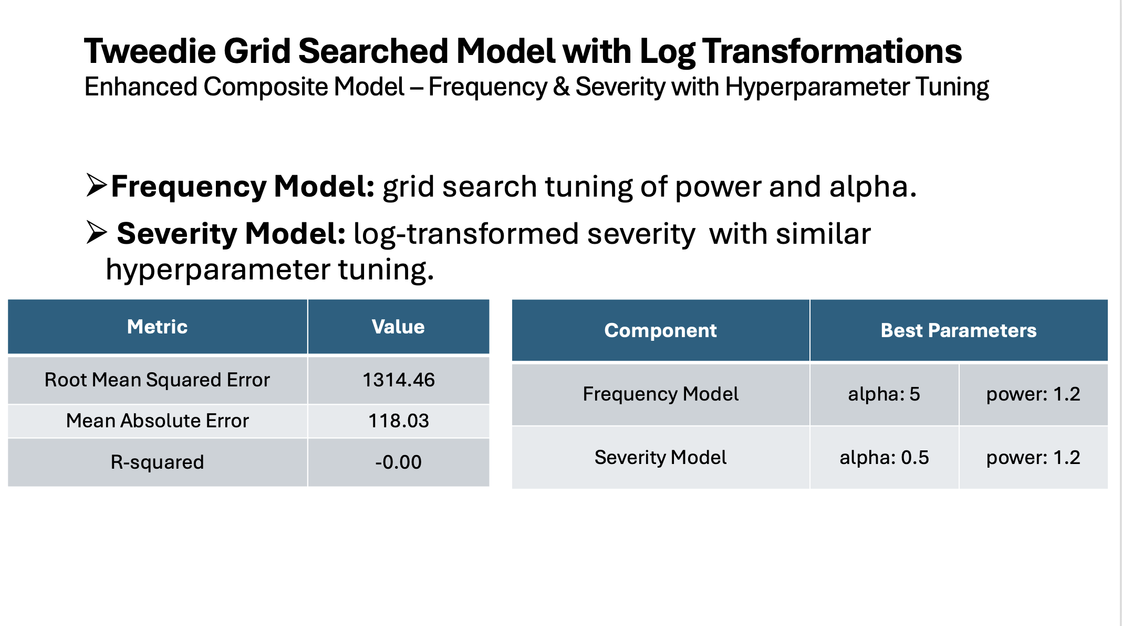

Slide 39
EXPERIMENTING IMPACT OF OUR RESULTS
Case 1: Tweedie + AutoML (Weighted Averaging)
Likely improves RMSE/MAE (closer to Tweedie’s 251.70/92.56),
but R² remains negative (~ -0.01).
Uncertainty estimates may become less precise due to AutoML’s high errors.
Training time: ~345s
Prediction time: ~1.64s.

Slide 40
EXPERIMENTING IMPACT OF OUR RESULTS
Case 2: Tweedie + Bayesian Ridge (Simple Averaging)
Reduces RMSE/MAE significantly (MAE possibly in 1000s)
R² still negative (~ -0.01)
Uncertainty estimates might be tighter if models align, but noise from Bayesian Ridge could interfere.
Training time: ~330s
Prediction time: ~0.61s.

Slide 41
EXPERIMENTING IMPACT OF OUR RESULTS
Case 3: Tweedie + Random Forest (Stacking)
Balances errors, with MAE potentially in 4000-5000 range
R² slightly better (~ -0.005).
Uncertainty estimates may widen due to Random Forest’s high variance.
Training time: ~2171s
Prediction time: ~4.83s.

Slide 42
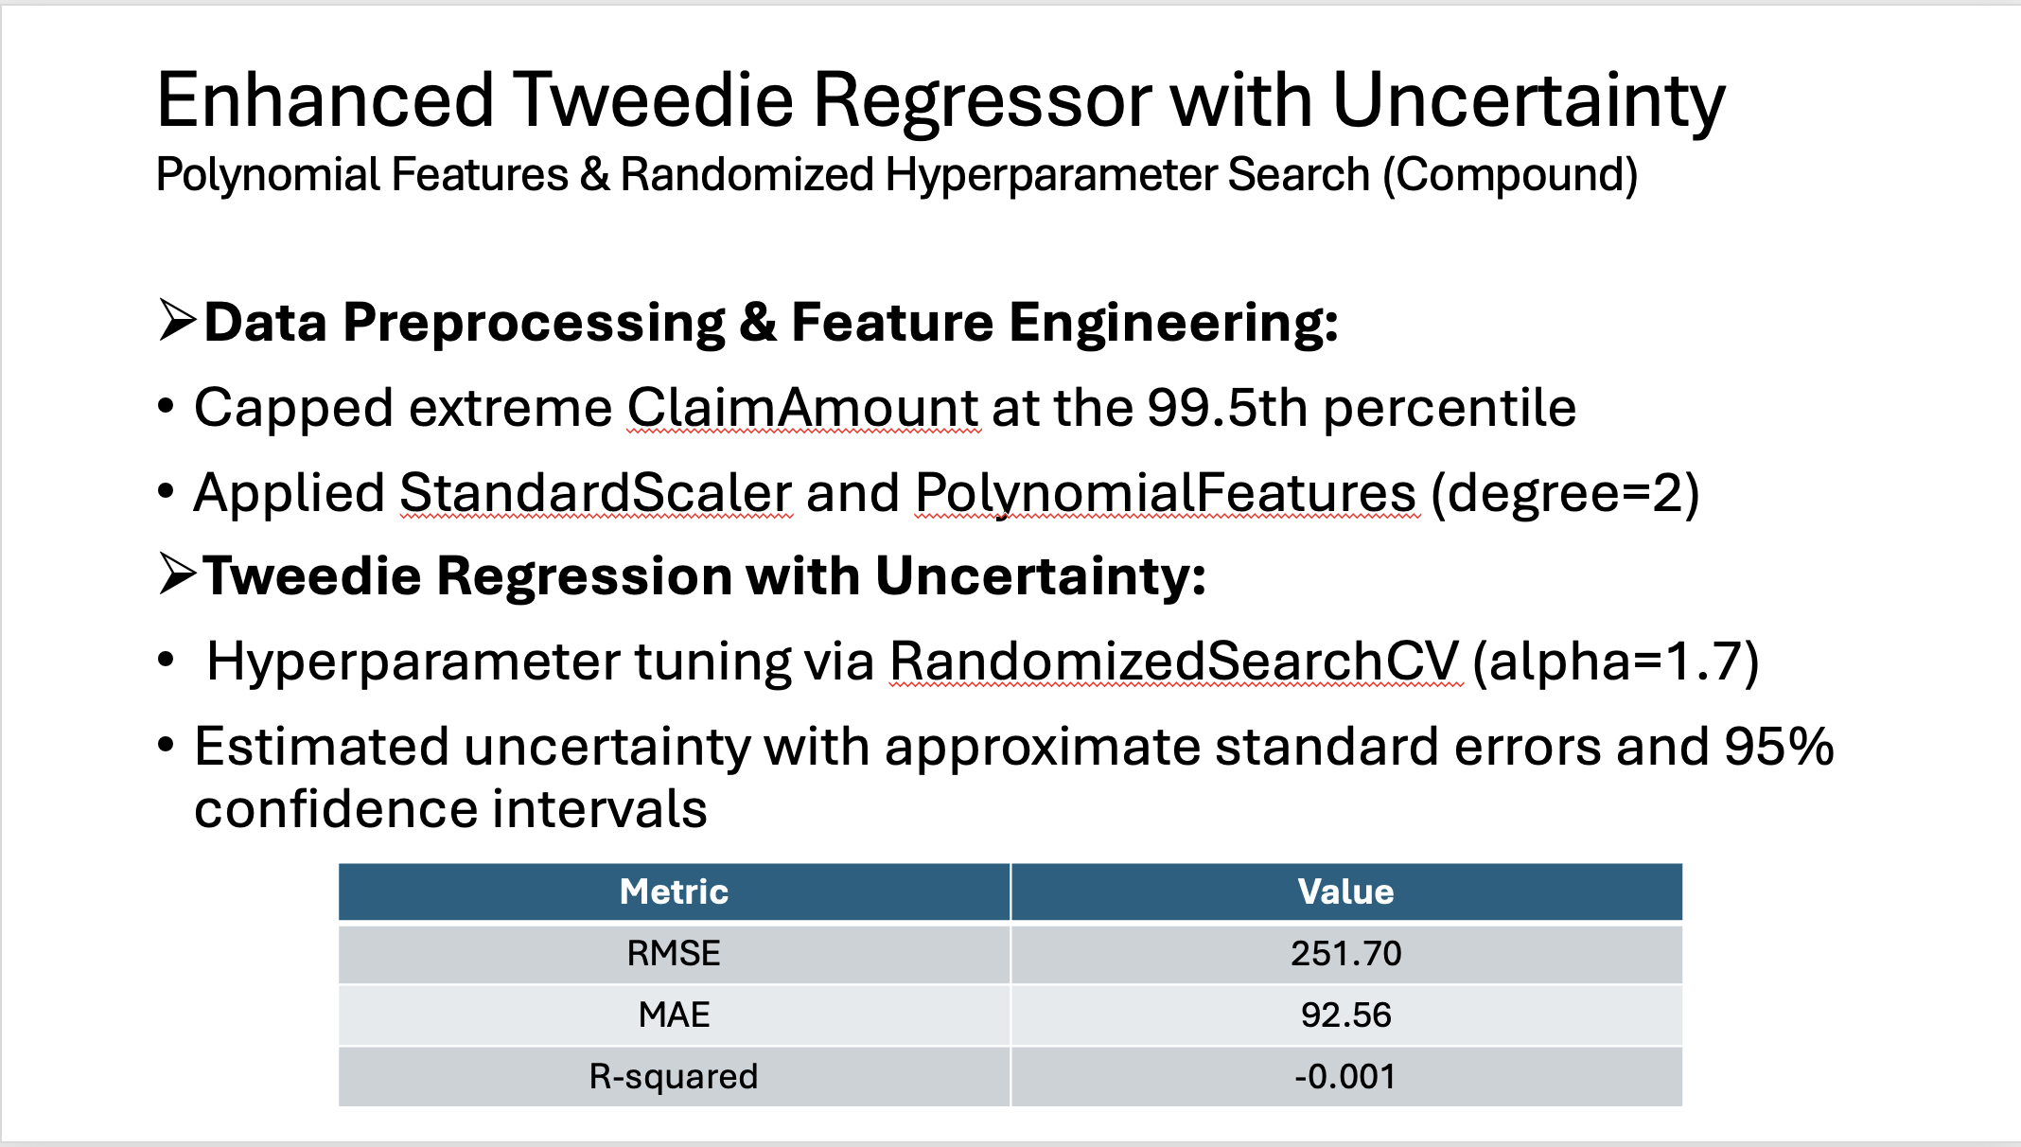

Slide 43
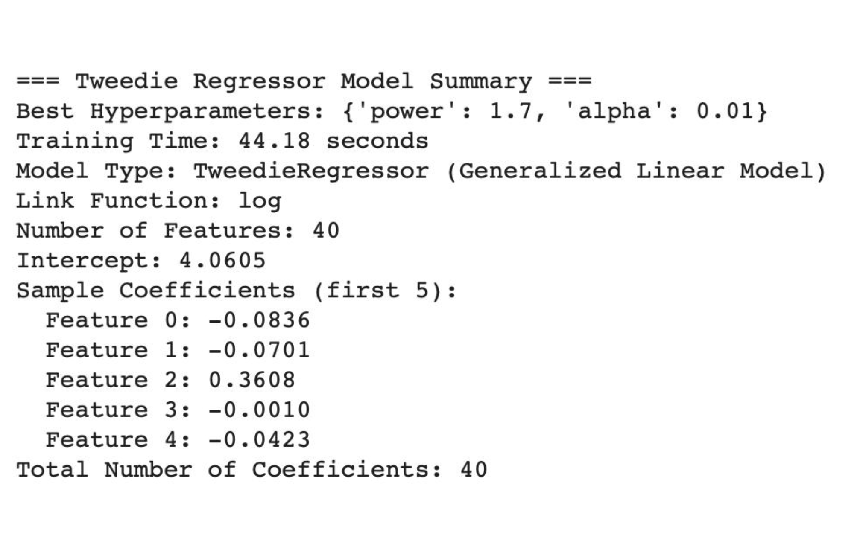
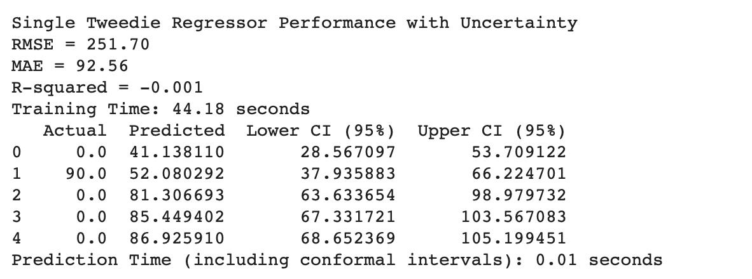
MODEL SUMMARY AND UNCERTAINITY QUANTIFICATION

Slide 44
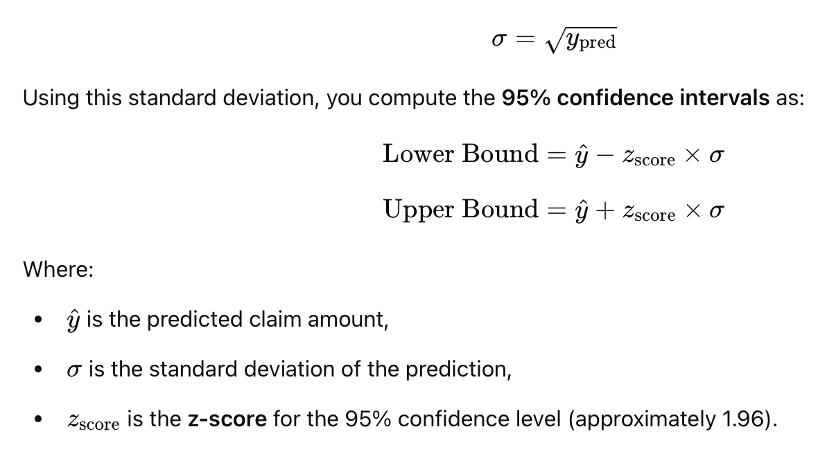
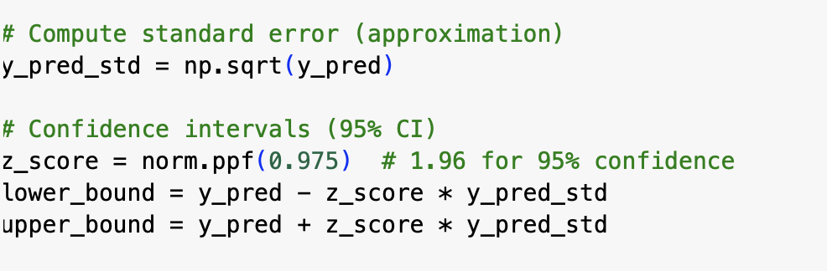

Slide 45
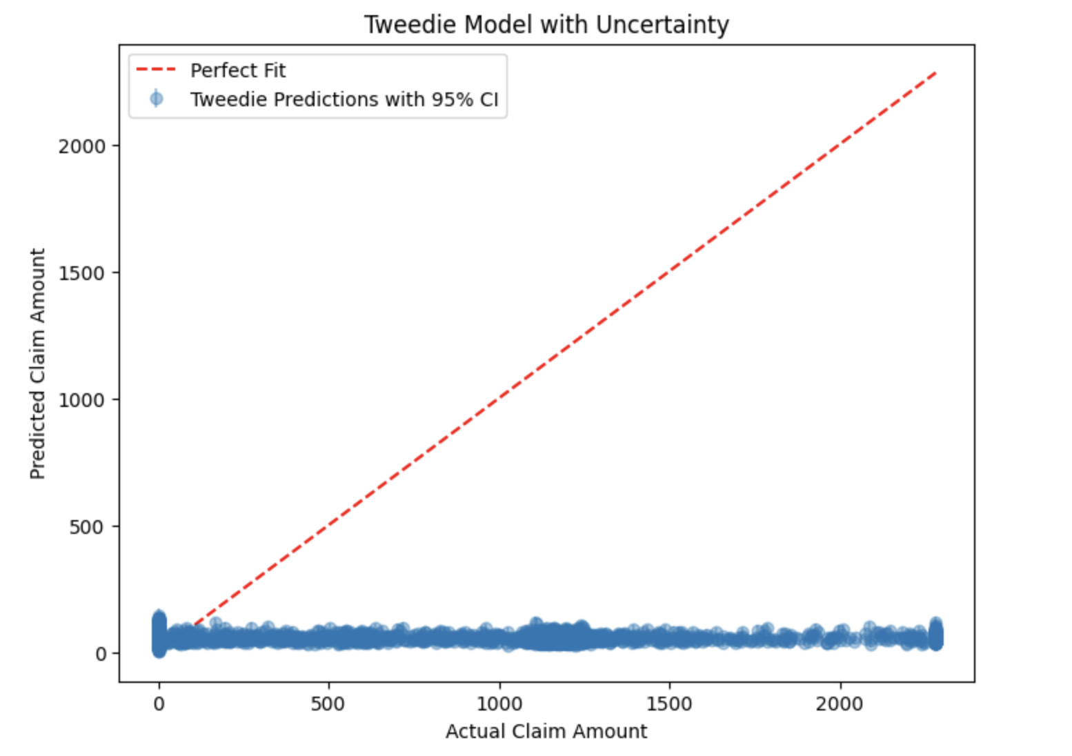

Slide 46
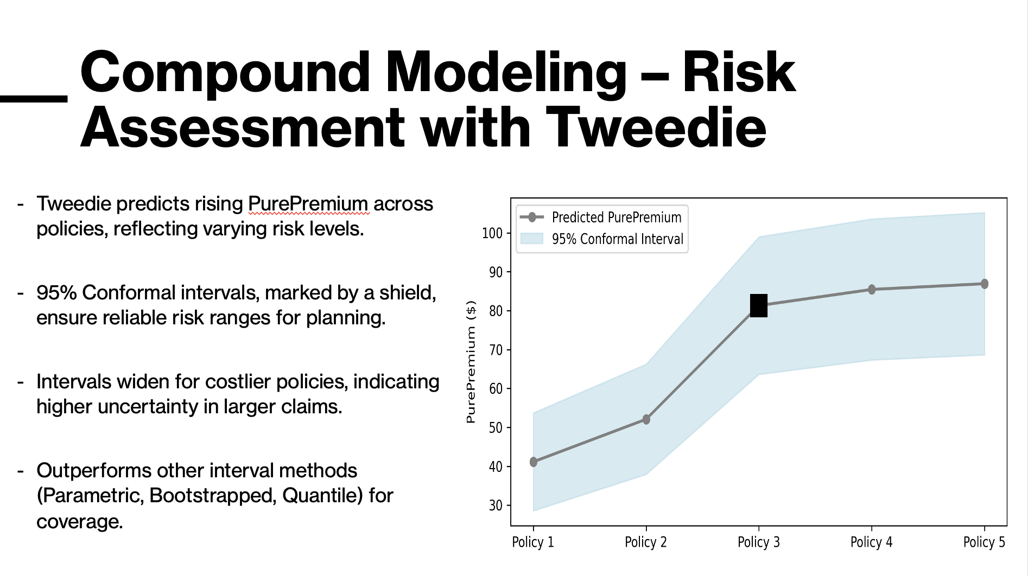

Slide 47
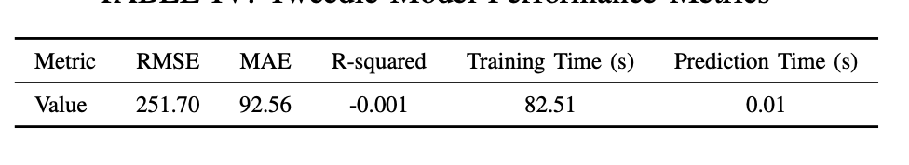
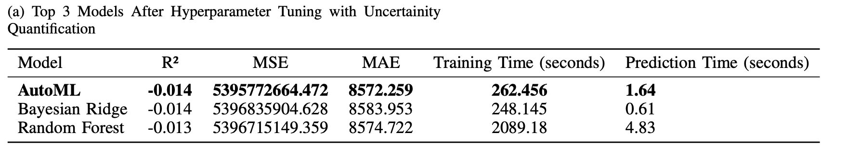
SUMMARY OF OUR FINDINGS
TWEEDIE REGRESSION WITH UNCERTAINITY QUANTIFICATION
COMPOUND MODELING (TOP 3 BEST PERFORMING) WITH UNCERTAINITY

Slide 48
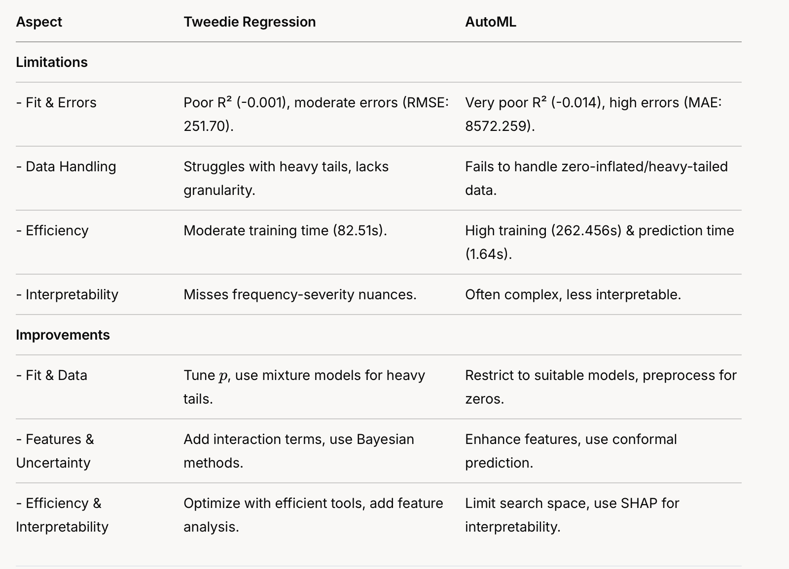
Limitations and Potential Improvements

Slide 49
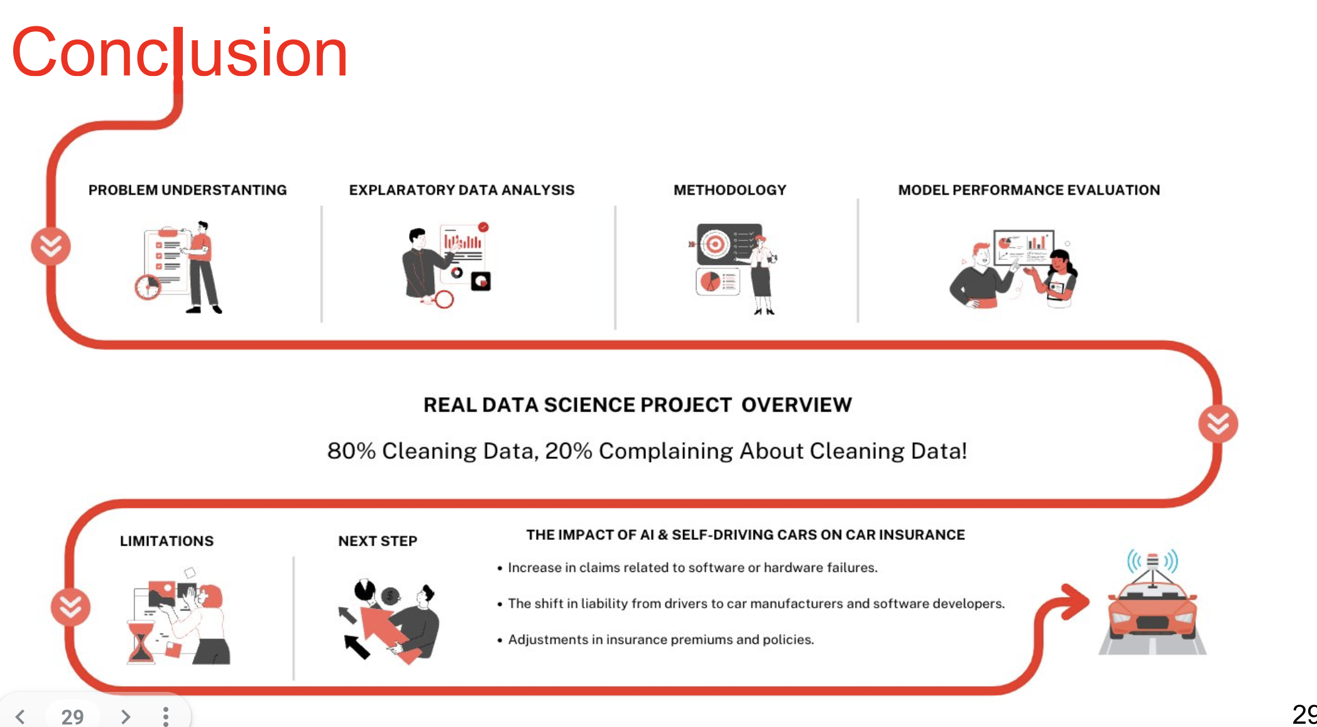

Slide 50

OUR LINKEDIN PROFILES
Laxman Sudhan
Ram Ridhan
Yash Mishra
Mufan Yang
Peng Xiang

Slide 51


